Slide 1
Theme: Management of Radiotherapy Acute Side Effects for Head and Neck Cancer Patients
Date: Tuesday, July 7th, 2020, 9 pm Japan, 7 am Houston 8:00 pm Taiwan & Philippines
13th ECHO ONE Clinic
Mentor: Dr. Amy Moreno (Department of Radiation Oncology, The University of Texas, MD Anderson Cancer Center, USA)
Case Presenter: Dr. Pei-Hsuan Lee (National Taiwan University Hospital Taiwan)
Facilitator: Dr. Hsiang-Kuang Tony Liang (National Taiwan University Hospital, Taiwan)
Commentator: Dr. Chun-Wei Wang (National Taiwan University Hospital, Taiwan) Dr. Warren Bacorro​ (University of Santo Tomas Hospital, Philippine) Dr. Tomoaki Tamaki (Fukushima Medical University, Japan)
Language: English
Organized by: J-TOP Project ECHO Planning Committee

Slide 2
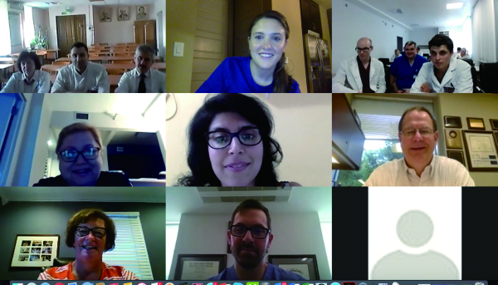
What is ECHO ONE:
ECHO ONE (Extension for Community Healthcare Outcomes,
Oncology Network Education) is different from previous webinars, where only professionals lectured to healthcare providers. It is not just a one-way meeting to listen to a lecture, but an interactive learning opportunity where participants can ask questions and discuss freely in a bi-directional-way.
This is a telementoring program that enables participants
to improve patient care, using an application called ZOOM,
which can be accessed not only from the workplace but also
from a PC or smartphone at home.
Please join the discussion!
How to Participate in ECHO ONE
Sign up for membership through the TeamOncology.Com https://www.teamoncology.com/seminar/project_echo_one After becoming a member, you can apply to this session.
so please register for this event.
Once you register, you will be sent a URL to join this ECHO ONE.
Contact：secretariat@teamoncology.com

