Slide 1
Theme:Preventing burnout for healthcare professionals
医療者の燃え尽きを防ぐために
Date: Tuesday, January 25, 2022 (6:30 AM Houston, 8:30 PM Manila/Taiwan, 9:30 PM Tokyo)
Project ECHO ONE Special Seminar 教育講演
Mentor: Dr. Eduardo Bruera (Chair, Department of Palliative, Rehabilitation, &amp; Integrative Medicine, MD Anderson Cancer Center)
Facilitator: Hisashi Suyama (Tottori University)
Language: English with Japanese simultaneous translation
英語（日本語の同時通訳がつきます）
Organized by : Project ECHO ONE Steering Committee

Slide 2
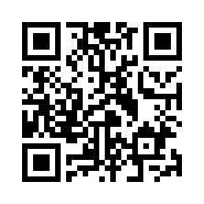
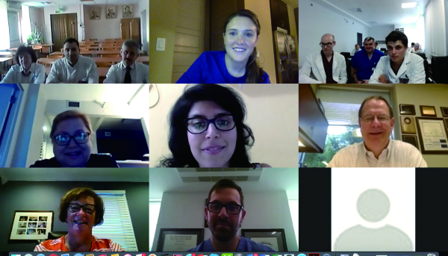
What is ECHO ONE:
ECHO ONE (Extension for Community Healthcare Outcomes,
Oncology Network Education) is different from previous webinars, where only professionals lectured to healthcare providers. It is not just a one-way meeting to listen to a lecture, but an interactive learning opportunity where participants can ask questions and discuss freely in a bi-directional-way.
This is a telementoring program that enables participants
to improve patient care, using an application called ZOOM,
which can be accessed not only from the workplace but also
from a PC or smartphone at home.
Please join the discussion!
How to Participate in ECHO ONE
Sign up for membership through the TeamOncology.Com https://www.teamoncology.com/seminar/project_echo_one After becoming a member, you can apply to this session.
so please register for this event.
Or, you can use the QR code below to access the registration form.
Once you register, you will be sent a URL to join this ECHO ONE.
QRコードから登録フォームにお進みください。→
Contact：secretariat@teamoncology.com

